Slide 1




PSYON – POWER BI PORTAL
Application Review

Slide 2

Agenda
Power BI Report Samples
Integration of Power BI reports to Portal
Application Architecture
Demo – Psyon Portal
Other Applications Demos – Accelerator Portal and Howden UK Dashboard

Slide 3

Features
Embedded Power BI dashboards in the Portal
Row Level Security(RLS) applied on reports based on user permissions
Azure AD Single Sign-on(SSO) implemented
Portal has dynamic menu based on user permissions to Power BI Workspaces or Reports

Slide 4








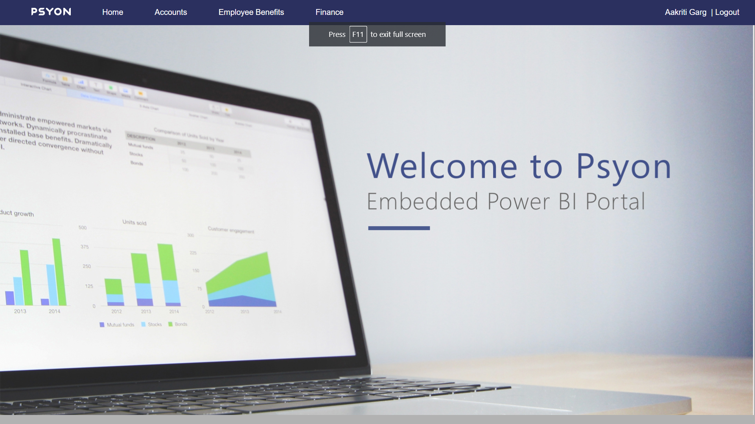



Application Architecture
Data Layer
API Layer/Azure
UI
SQL Server
Power BI
CI & CD
App Service Plan
Dashboards
Azure Resource group
Tabular Cube
Reports
Datasets
RLS
Sources Systems
Technology stack : ASP.NET MVC, C#.NET, Azure AD, Azure App Service, Azure DevOps, Application Insights, Power BI Cloud

Slide 5

Application Demo
Psyon Portal URL: https://psyon-power-bi-portal.azurewebsites.net
Accelerator Portal URL: https://accelerator.hyperiongrp.com
Howden UK URL : https://accelerator.hukdashboards.hyperiongrp.com/login

Slide 6


